Slide 1

Agent Activity Chart
6/28/2022 9:43 PM
Print User : automation
Page 1 of 3

Slide 2
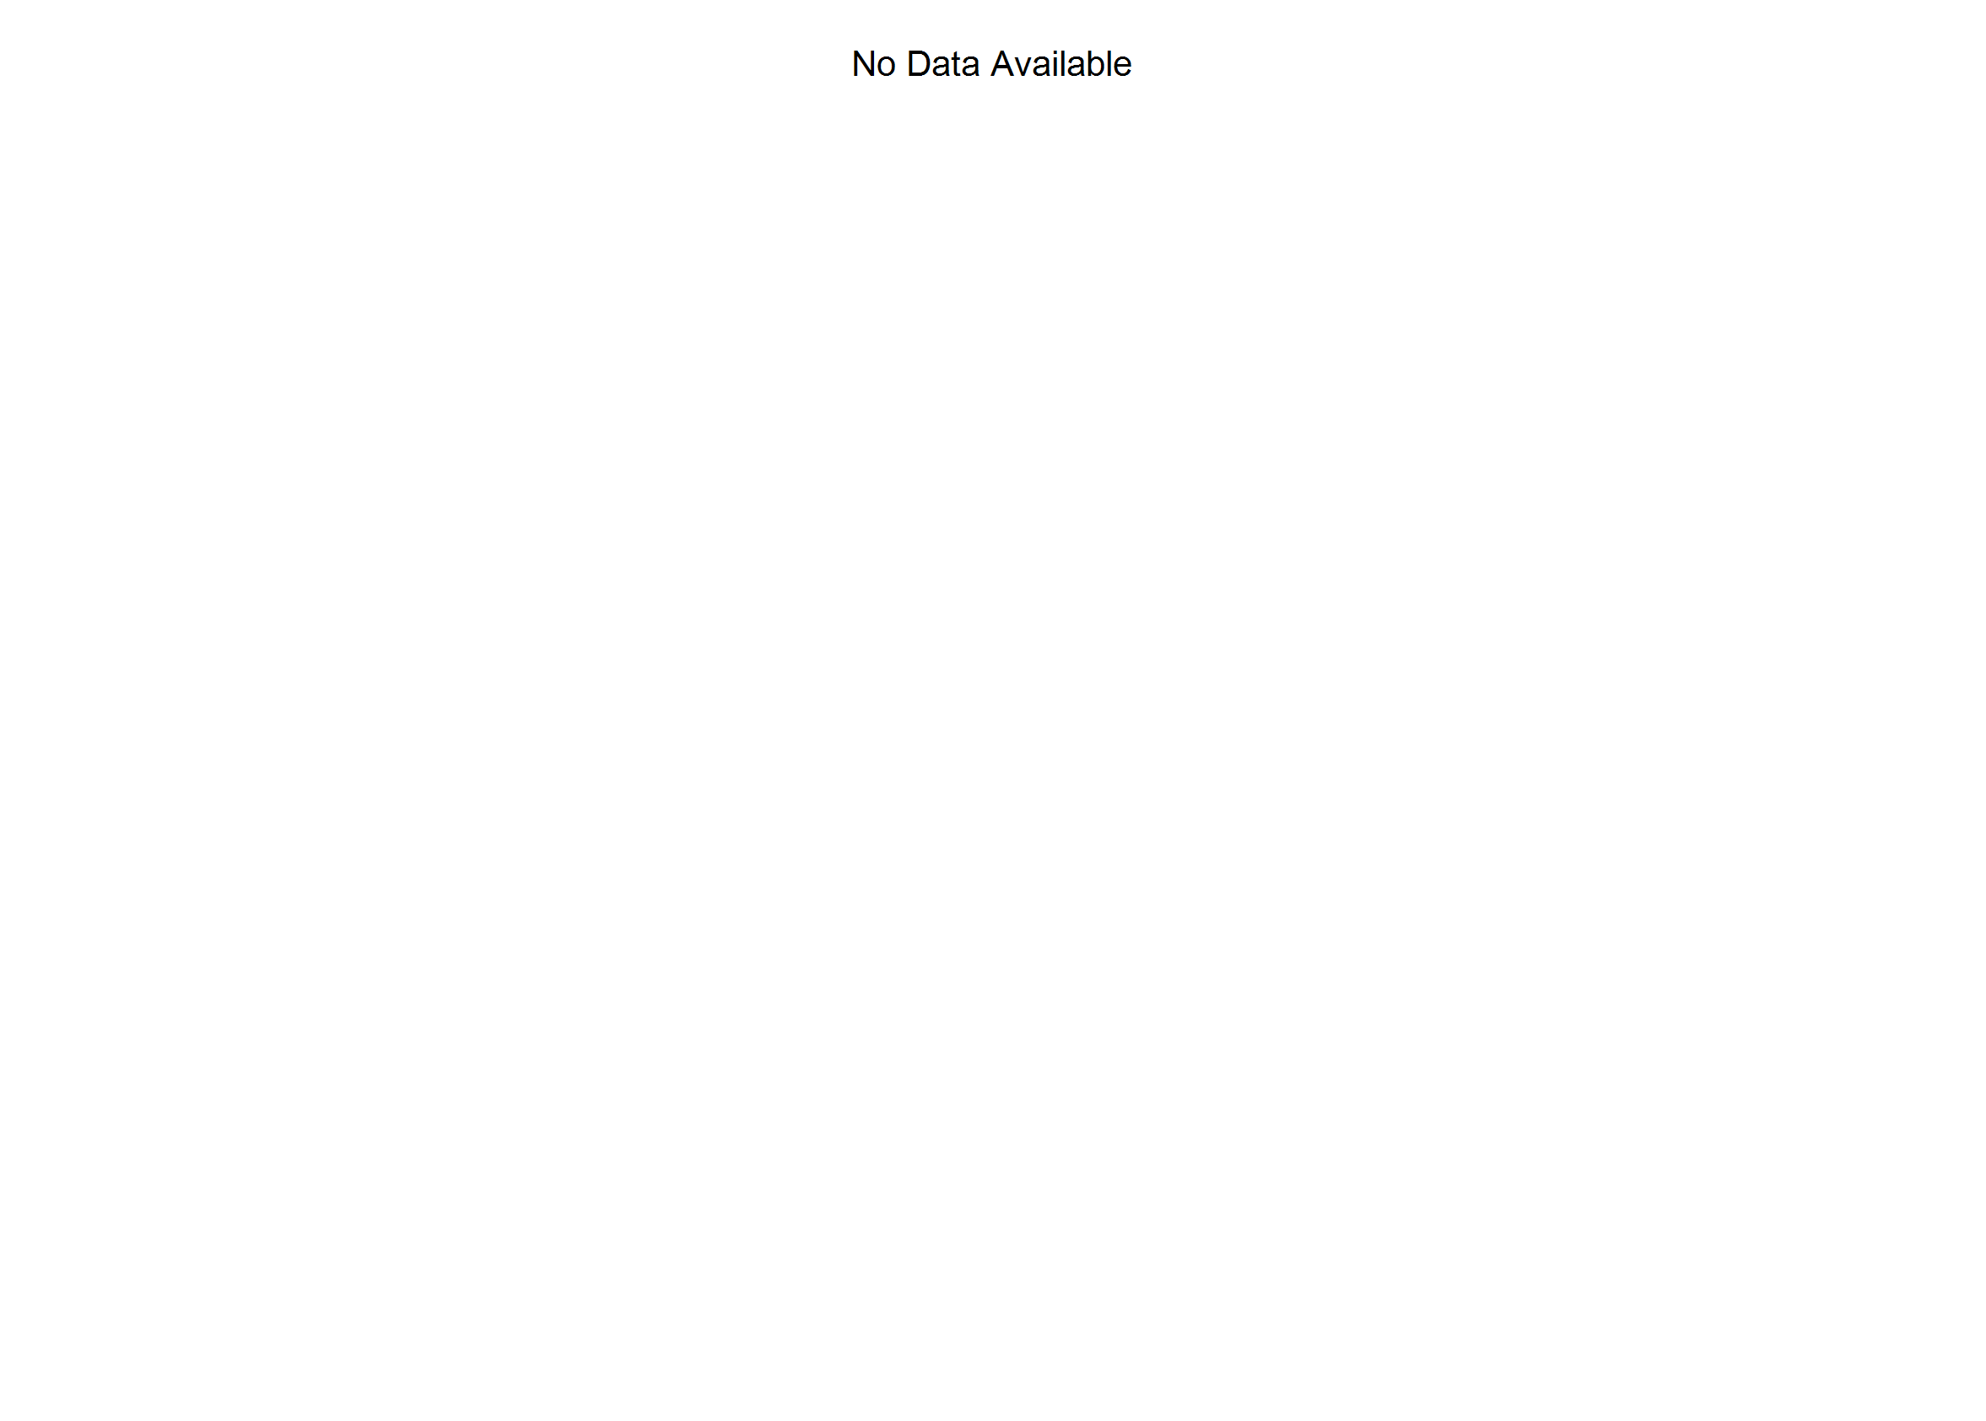
6/28/2022 9:43 PM
Print User : automation
Page 2 of 3

Slide 3
6/28/2022 9:43 PM
Print User : automation
Page 3 of 3

